Slide 1
DCMA Commercial Item Group
Commercial Acquisition & Determination Authority
Mr. Ryan Connell
Director, Northeast Commercial Pricing
18 July 2019
Unclassified//For Official Use Only

Slide 2
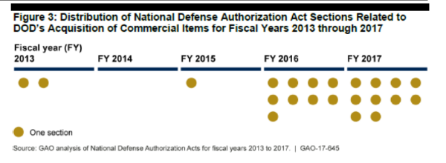
Commercial Acquisition
  NDAA 2013
    Created a cadre of experts for commercial acquisition, led to CIG
  NDAA 2016:
  - Restricted the PCO’s ability to change a commercial decision; HCA to overturn
  - Reliance on prior Government prices paid
  - Added scrutiny to convert from a FAR 12 to FAR 15
  - Required a database for recommendations and determinations of commerciality
  NDAA 2017
    Emphasized market research for price analysis
    Added many commercial related pilot programs
  NDAA 2018
    Directed establishment of a program for buying COTS items on the internet
    Established the existence of prior FAR 12 buys as a basis for commerciality
  2018-2019 DFARs updates
  NDAA 2019
  NDAA 2020
Notes:
So besides those benefits we just outlined, there’s also the legal considerations…
What you have here are regulations encouraging commerciality at various levels and entry points within the Government
Its in the guiding principles of the FAR in 1.102, incorporated with IT products and services as seen in NDAA 2018, in Contractor purchasing systems administration in the DFARS clause, and the preference is even outlined for Primes to flow down to their subs as seen in 52.244-6.

Slide 3








Leadership Need for Speed
“We need to move faster!”
Dr. Griffin, USD(R&E)
“It’s all about velocity”
Ms. Lord, USD(A&S)
“Focus on speed-to-field”
Mr. Shaffer, DUSD(A&S)
“Speed is our focus”
Dr. Roper, USAF SAE
“U.S. lost its ability to go fast”
Gen Hyten, USSTRATCOM
“We have to go faster”
Mr. McCarthy, USecA
“Velocity is my advantage”
Mr. Guerts, Navy SAE
Ricky Bobby
© 2019 The MITRE Corporation. All rights reserved. Approved for public release. Distribution unlimited 17-3828-3.

Slide 4
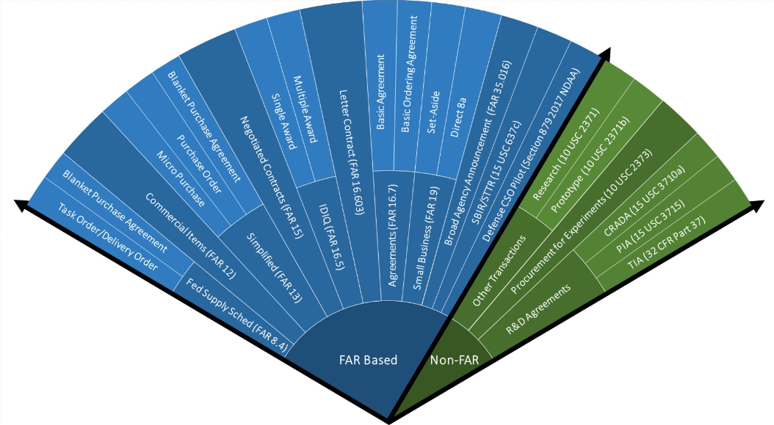
DAU Contracting Cone
Notes:
https://www.google.com/search?q=dau+contracting+cone&source=lnms&tbm=isch&sa=X&ved=0ahUKEwi4-uyowtDiAhUBmuAKHSqhCUoQ_AUIECgB&biw=1920&bih=932#imgrc=QqMiBclgMVuZnM:&spf=1559675052601

Slide 5
Acquisition Thought Process
5
Are commercial items available?
Can the requirements be modified to fit a commercial item?
Identified Need
No
Can a commercial item be modified to fit the requirements?
No
No
Yes
Yes
Yes
Pursue Commercial Item
Procurement IAW FAR Part 12
Pursue Other Than
Commercial Item Procurement
Notes:
Mission starts with requirement building..
pre solicitation. The altimeter is a great example. Ok we do our market research and the required Altimeter NSN 1000 900 4444 is not commercially available. Don’t stop there. What about that Garmin one we talked about, if I were to put that in my aircraft, do I simply need to add a different bracket so it can bolt in?
Pam: let’s make a new slide with pictures to illustrate this altimeter case

Slide 6
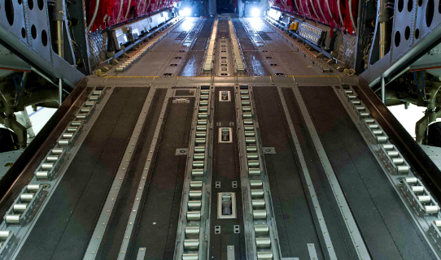
Story Time:
COOLS: Cargo on/off Loading System
  Supply Chain
  Price
Copyright © Boeing. All Rights Reserved.
Notes:
First 3 bullets..
First thing data mine the contractor’s website – typically a high level overview of the item/systems, but it’s a start.
Contractor CID provides some background, the COOLS is a cargo loading system for the CH-47 Chinook which replaced the old Helicopter Internal Cargo-Handling System (HICHS). The HICHS required the helicopter to be grounded and needed three soldiers to work for approximately four hours to configure. If a mission changed while en-route, the helicopter was required to go back to base for reconfiguration, causing delays in response time. The COOLS can be reconfigured mid-flight, by a single soldier, in about fifteen minutes.
Be wary of the sales pitch on company websites and contractor CIDs…
Bullet 4
Then requested a detail breakdown of parts included in kits from the contractor. Hoping to proceed with a review of the specific parts. Contactor did not provide information in time to complete the review for the customer.
Had also asked the contractor for more information one of those questions was what % of the overall COOLS product do the kits make up? The answer 90%! Pivot MR focus to compare the entire cool system to other cargo loading systems.
The CIG engineer was able to find similar loading systems, but do not typically need to be convertible, and certainly do not need to convert in-route. So we have similar systems out there but theres modularity modifications that need to be reviewed to assure that they can be considered minor.
Bullet 5
Cargo loading system were contacted to request ballpark estimates for the entire loading system.
Bullet 6
The ability to swap between roller side up for easy loading of palletized cargo, and roller side down, creating a solid, flat surface capable of safely accommodating personnel. Because it is a modular system, with individual panels, the system can also be partially configured in combinations to provide space for a combination of both cargo and personnel. -- Engineer found that this does not materially affect the load systems overall function.
In the end, because the additional analysis on the overall cool system it was considered it an “of a type” item, the kits contained in the cools, and that make up 90% of the end item, were recommended commercial with minor mods available to meet the Gov’s requirements.
But the kits do not change the function of the COOLS.

Slide 7

Story Time:
Palantir – Deployable Ground System
  Delivering relevant Technology
  “This is how we have always done it”
Notes:
First 3 bullets..
First thing data mine the contractor’s website – typically a high level overview of the item/systems, but it’s a start.
Contractor CID provides some background, the COOLS is a cargo loading system for the CH-47 Chinook which replaced the old Helicopter Internal Cargo-Handling System (HICHS). The HICHS required the helicopter to be grounded and needed three soldiers to work for approximately four hours to configure. If a mission changed while en-route, the helicopter was required to go back to base for reconfiguration, causing delays in response time. The COOLS can be reconfigured mid-flight, by a single soldier, in about fifteen minutes.
Be wary of the sales pitch on company websites and contractor CIDs…
Bullet 4
Then requested a detail breakdown of parts included in kits from the contractor. Hoping to proceed with a review of the specific parts. Contactor did not provide information in time to complete the review for the customer.
Had also asked the contractor for more information one of those questions was what % of the overall COOLS product do the kits make up? The answer 90%! Pivot MR focus to compare the entire cool system to other cargo loading systems.
The CIG engineer was able to find similar loading systems, but do not typically need to be convertible, and certainly do not need to convert in-route. So we have similar systems out there but theres modularity modifications that need to be reviewed to assure that they can be considered minor.
Bullet 5
Cargo loading system were contacted to request ballpark estimates for the entire loading system.
Bullet 6
The ability to swap between roller side up for easy loading of palletized cargo, and roller side down, creating a solid, flat surface capable of safely accommodating personnel. Because it is a modular system, with individual panels, the system can also be partially configured in combinations to provide space for a combination of both cargo and personnel. -- Engineer found that this does not materially affect the load systems overall function.
In the end, because the additional analysis on the overall cool system it was considered it an “of a type” item, the kits contained in the cools, and that make up 90% of the end item, were recommended commercial with minor mods available to meet the Gov’s requirements.
But the kits do not change the function of the COOLS.

Slide 8


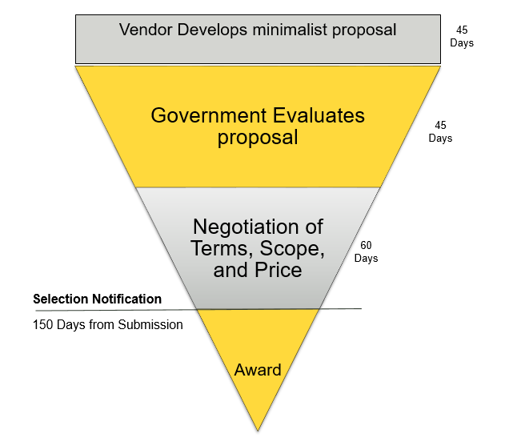
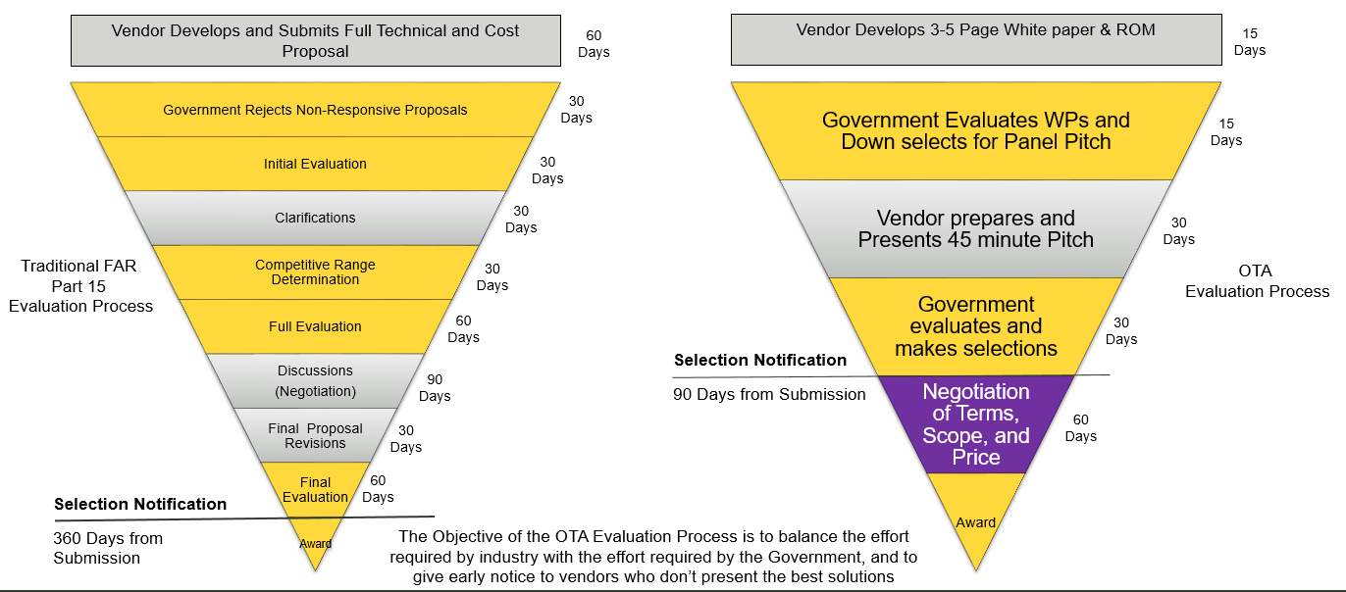
PALT & DCMA Proposal Reviews
NOTIONAL
(Photo Credit: U.S. Army)

Slide 9
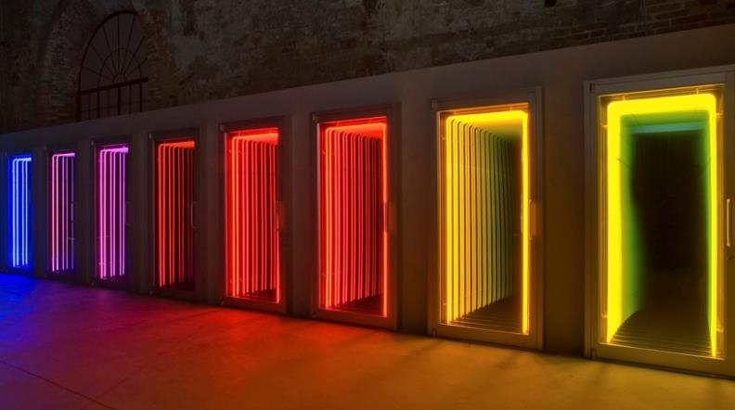

Commercial Definition (FAR 2.101)
“Of a Type”
Evaluate “Similar” item
Customarily used
The Eight Paths to Commerciality
Notes:
We can't really start talking about commercial items and services, without first reviewing and considering the FAR definition. First let me say that some definitions are more prevalent than others, and therefore unless someone in the audience wants more detail we’ll focus primarily on definition 1 and 3 and briefly go over the others.
And later when we discuss NDAA 2019 we’ll talk about some changes in the pipeline for the definition.

Slide 10
Misconceptions About Commerciality
The products of a “commercial company” are always commercial.
Non-developmental items are always commercial.
If an item is developed at private expense, it must be commercial.
An item that has no commercial sales data cannot be commercial.
If you list it on your company’s website then it’s automatically commercial.
Invoices can be “too old” for consideration in commerciality.
If it’s commercial, the asking price must be fair and reasonable.
Catalog prices are automatically fair and reasonable.
Notes:
Here some things we see a lot…
Important to note the FAR does not identify a “commercial company” rather just items and services.
List it on your companies website, highjack one of Ryan’s favorite stories of being in a negotiation with a company and stating the item is not being offered for sale and within minutes someone within the IT dept. had posted the item for sale on the companies website.
Age of an invoice may play an important role for PA, but for commerciality it depends on the product, how often are space ships being procured vs. a microchip?

Slide 11
Roles and Responsibilities
Government issues FAR 15 Solicitation
  Prime Contractor takes exception to the FAR15 Clauses, needs to justify commerciality
Government issues FAR 12 Solicitation
  Government performs market research to determine commerciality (FAR 12 or 15 RFP)
  Prime contractor needs to support price reasonableness in the sole source proposal
  Government PCO should engage pricing experts, engineering & DCMA CIG, for support
  Government PCO is required to have a written D&F – CID on any commercial buys over $1M
FAR 15 Non-Commercial Prime with commercial Subcontracts
  Prime Contractor shall perform a Commercial Item Determination, using Market Research and guidelines in FAR Part 10. (244.402)
  Prime contractor submitting a Subcontractor “assertion of commerciality” is not meeting the requirement
  Prime Contractor shall perform price analysis on the subcontractor
  PCO still has responsibility to make sure prime proposal, including CIDs is adequate and price is fair and reasonable
Decisions, no matter who is responsible, rely heavily on Market Research

Slide 12
How to Tackle Market Research?
Prepare
  Ensure an understanding of the key characteristics of the items/service you are reviewing and identify any data necessary to support the commerciality recommendation and price analyses.
Collect
  As many data points as possible!
  TRIZ method of problem solving
  CIG webpage – has a wiki page for helpful market research websites
Organize
  Consolidate market research findings into a priority of product(s) or service(s) considerations, relevant to the proposed commercial item analysis.
  Remember FAR Part 10 requires that market research results be documented in a manner appropriate to both the size and complexity of the acquisition.
Notes:
Most of us are familiar with the market research concept. It’s elementary right , we all do it in our everyday lives, when we want to purchase a car or tv?
But within this very basic task holds the essential building blocks for commercial acquisitions, serving as the basis for not only the CID but also the price analysis.
Remember market research is a continuous process designed to gather data on products and services, industry standards, market capabilities and the business practices associated with them. It can identify potential solutions as well as create greater competition by expanding the supplier base.
MR is a snowflake, completely individual, and I have to remind myself of this, and to not go through a MR routine (check Partsbase, haystack, the company’s websites, etc), and think outside the box when it comes to gathering data points.
Prep: I find it helpful to set up a call with the requestor or any government team, to understand the item, the market, what’s the item being used for, on what project, what is the core function.
Org: Strive to allow your effort and work to be a building block for the next person.

Slide 13
Focus on the Price
Evaluate price, not cost
  Cost plus a certain profit is not the F&R way to look at commercial pricing
  PB&J example
Price Analysis Techniques
  Comparison to other prices received from other companies
  Comparison to historic prices paid
  Parametric estimating methods
  Government cost estimates
  Market research on same or similar items (NDAA 2017 – required)
  Data other than certified cost or pricing data
  Value based pricing (NDAA 2017 – allowable)
What we do (CIG)
  Use as many as possible
  Be a Problem-Solver/Magician/Guesstimator/Artist
  Leverage commerciality with Pricing (Targeting System)

Slide 14

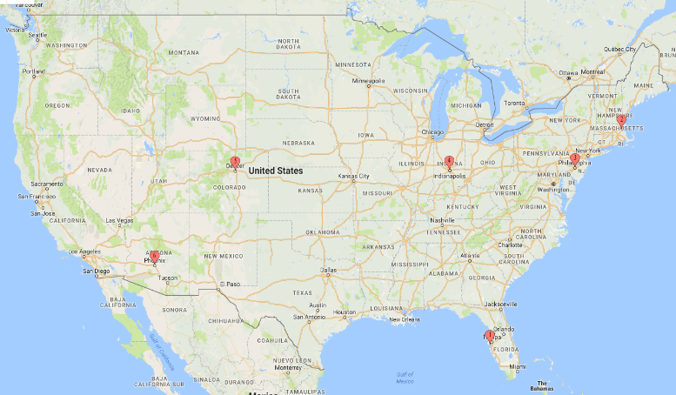
CIG Teams & Locations
Denver, CO
Markets: Space (Spacecraft and Lift), C4I (Systems, Cyber and Services), UAS
Indianapolis, IN
Markets: Automotive, Aeronautics, Aircraft Engines
Boston, MA
Markets: Services (MRO),
Chemicals and Materials
CIG staff
Price/Cost Analysts: 37
Engineers: 20
Management
Analysts: 1
Director: 1
Philadelphia, PA
Markets: Naval Transport & Equipment, Troop Supply (Shelters, Personal Equipment)
+5
Phoenix, AZ
Markets: Heavy Machinery, Missiles
St. Petersburg, FL
Markets: Vehicles, Weapons, Ammo
Notes:
Currently there are 6 centers within the CIG broken down by industry expertise. Now the original intent was for each location to become an expert in that field but case assignments are also based on workload and bandwidth so the for instance the Boston team does not only review Services, Chemicals and Materials.
The CIG has a total staff of 59 people with about a 60/40 split between price cost analysts and engineers.

Slide 15
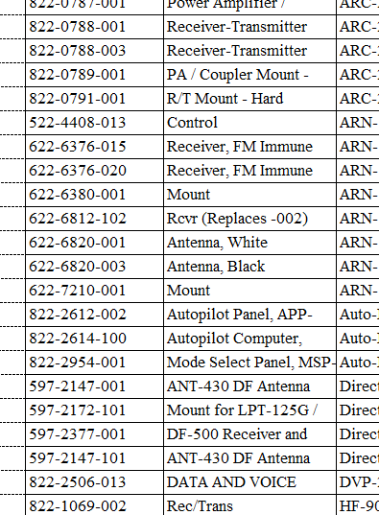
Commercial Item Database
Currently maintained in Excel format
DPC is exploring the next version of the database
More than 18,000 parts – and growing
Not all-inclusive (but we’re working on that)
Sources of data:
  Commercial Item Determinations by Procuring Contracting Officers
  Commercial Item Recommendations by CIG personnel
  Will incorporate new Commercial Item Determinations performed by the CIG
Notes:
NDAA 2016 outlined the need for a centralized database for commercial recommendations and determinations
Get updated numbers from Danielle
DPC database features?

Slide 16
Today’s CIG
Warranted Price/Cost Analysts!
New CIG Thresholds
  Commercial Only Cases: $1 M
  Commercial and Pricing Cases: $1 M
  Pricing Only Cases: $2 M
      CMOs can perform price analysis requests under $2M
Send Commercial Request Form:
  Or visit our website:
  https://www.dcma.mil/Commercial-Item-Group/
Notes:
Letter issued by Kim Herrington the Acting Principal Director for Defense Pricing and Contracting

Slide 17
Tomorrow’s CIG
809 Panel Volume 3
Price Capability
  Should Cost/Should Price - Transdigm
  Non-Traditional Defense Contractors
  OTAs
Industry Requests
Risk-Based intake approach
Doing the “right work”
  Resources, AIRS, PALT, DoD impact
Notes:
The Section 809 Panel – an independent advisory panel on streamlining DoD acquisition regulations
One of the goals of the Section 809 Panel : Review the acquisition regulations applicable to DoD with a view toward streamlining and improving the efficiency and effectiveness of the defense acquisition process and maintaining defense technology advantage
Provide acquisition insight for the integration of commercial products and services within DoD to streamline procurements and ensure warfighters receive cutting-edge technology at fair and reasonable prices.”
In a short 3 years, the CIG has come a long way in defining our roles within the agency, coming up with best practices, creating a deskguide, engaging private industry, introducing ourselves to buying commands, putting on a 200 person conference…more stuff?

Slide 18
Questions?
Let’s make a difference

Slide 19
Backup Slides

Slide 20
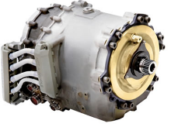
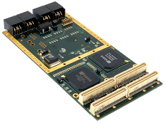

Commercial Acquisition, Why Do It?
For Industry
  Exception from submitting certified cost or pricing data
  Streamlines the acquisition process
  Eliminates (most) government-unique terms and conditions
  Potential opportunity for companies with no prior history working with the Government (non traditional defense companies)
For Government
  Leverage the commercial marketplace
  Technical Innovation
  Emerging Technologies
  Price Competition
  Economies of Scale
  Expand Supplier Base
Notes:
So why the push for commerciality? Why such an emphasis?
Well lets look at some of the benefits for commercial acquisitions…
Ind:
Top of the list, are the exemptions associated with commercial items and services.
Most notably the TINA exemption, eliminating the defective pricing liability.
Lessen the bid proposal effort
Gov:
Primary benefit, leverage the commercial marketplace
Capitalize on the technical innovation, emerging technologies, expand the Government’s supplier base, decrease the use of sole source vendors,
Reduced acquisition cycle times; which lower life cycle costs; increased competition,
Avoid the cost of product development, why pay for a company to create something when there may be a commercial variation already available that can meet our need?
Put simply when available, (key word) commercial acquisitions makes good business sense for both parties.

Slide 21
Market Research Reminders
There is no single website, person, or tool that has all the answers.
There is no standard checklist or template, since each part or service has its own unique circumstances.
Be creative, use your own best judgment.
Combine all sources of information to paint a complete picture, and…
…ALWAYS, ALWAYS DOCUMENT YOUR FINDINGS!

Slide 22
Determination Authority
December 20, 2018 letter issued to Armed Services
    “DCMA CIG Contracting Officers will serve as determining official for all commercial item review requests submitted to DCMA.”
January 9, 2019 Determination Authority goes live for the CIG
    CIG will only be issuing Commercial Determinations and no longer recommendations.
February 8, 2019 Admiral Lewis, DCMA Director, issues letter to component heads:
    Establishes DCMA CIG Contracting Officers as DCMA’s determining officials for all commercial items/service review requests submitted to DCMA from buying activities/PCOs.
Notes:
Originally the CIG provided only recommendations to the PCO, who then made the final determination.
But after a good deal of discussion internally and then with leadership within the agency the CIG petitioned to allow this capability.
January 9 – 3 pricing leads that passed the board and now have their warrant authority.
Feb 8 – a final announcement from the Director
With this new authority, we are able to take on more responsibility and ownership of the product within the agency. Mitigate the occurrence of CIDs that are overturned, with more consistency and to further assist the every busy PCO.
One thing I think these letter/memos leave out is that we are not taking away the PCO ability to make a determination, their role in a determination if they feel so inclined doesn’t change. Our role has but theirs has not.

Slide 23
Focus on the Price
Evaluate price, not cost
  Cost plus a certain profit is not the F&R way to look at commercial pricing
  PB&J example
Be a prudent business person
Understand the competitive market conditions
  Direct competition, if commercial, why isn't it being competed
  Who makes products/services similar? Who buys besides USG?
Reasonable knowledge of the market
  What has the Government paid, what do others pay?
  What is the value of the item/service; complexity, risk, difficulty
Collecting data, and compiling it all to make informed recommendation

Slide 24
Commercial Item Definition (1)
  Any item that is OF A TYPE customarily used by the general public or by non-government entities for non-government purposes, and has been sold or offered for sale, leased, or licensed to the general public.
  Key Questions/Concepts/Considerations:
    Ensure you understand the item or service.
    Compare the proposed item to the commercial market options (are there variations? How does this affect the form, fit, and function?).
    Know who the buyers and sellers of the item are.
    Are commercial/nongovernment invoices available?
    Are catalogs offered to the general public?
    Consider context and industry practices.
Notes:
Start with definition 1 and let me qualify that these are abridged versions of the definitions to fit this presentation.
Def
I want to first point out that the “of a type” definition is inherently predicated on an interpretation of a commercial item, otherwise it would be a COTS item!
There are two parts to this definition. Before and after the “And.” First section involves the evaluation of the item and establishing commercial equivalents.
Here you’ll want to gather commercial information on the item you are reviewing, utilize the contractor’s CID, and leverage your strategic and tactical market research, to establish whether the item has functionality and purpose in the commercial world.
The second part of the definition, this is where you’re looking for good faith sales evidence. I say good faith because you can’t just put a Bradley tank on craigslist and state its offered for sale so its commercial. Be cautious in your review of sale invoices, lots of companies service both military and commercial customers, so in these instances you really need to do some investigative research to tie back the invoice to the commercial side of the house for the company.
Key Q
Lastly it’s important to remember the “of a type” language in the definition provides broad latitude to the contracting officers. This is purposeful in nature, and meant to encourage acquisitions of commercial items by the Department.
With that said because of the broadness of the definition’s language expect some hurdles as you go through your analysis.

Slide 25
Commercial Item Definition (2)
  An item that would fall under definition (1) except that it hasn’t hit the marketplace yet, but it will hit the marketplace by the time the government needs it.
  Key Questions/Concepts/Considerations:
    Evaluate past/evolved item’s CID
    Are there product launch documents?
    Are there contracts in place for future delivery of the item?
    Will the availability of the item be the same for the Government as it will be in the commercial marketplace?
Notes:
Def 2.
Most of the time this definition would center around an item that has evolved from a commercial counterpart, so you may be able to start by reviewing the past versions as a baseline then delve into the upgrades to the new model.
Example: Think of this next years car model.

Slide 26
Commercial Item Definition (3)
  An item that would fit paragraph (1) or (2) BUT FOR
  (i) Modifications that are customarily available in the commercial marketplace, or
  (ii) Minor modifications to meet government requirements but do not significantly change the functional characteristics of the item
  Key Questions/Concepts/Considerations:
    Comparison items and details of the modification
    Manufacturing process, same/different lines?
    Drawings, specifications, contract terms and conditions
    Does the supplier perform similar modifications for non-Government customers?
    Do manufacturers routinely modify items to meet customer needs?
Notes:
Def 3.
We are well aware that many industries allow for customization and modification as a standard commercial practice, so it’s important to note that modifications can be extensive and still meet this part of the definition.
Key Q
Details on the modifications (differences)” is typically where commercial item packages have the biggest shortcomings.
Contractors are thrilled to highlight the similarities, but are silent on any differences. I could argue the differences play a significant role in the analysis for this definition and must be addressed in your analysis.
Also be cognizant of the importance of the similarities of the item. For instance showing that an APU uses the same screws, washers, bolts, and filters, may not constitute the essence of the item.
Later on we’ll see a case example of a minor modification.

Slide 27
Commercial Item Definition (4)
  A combination of items that can fall under definitions (1), (2), (3), or (5)
  Key Questions/Concepts/Considerations:
    In most instances, a combination of commercial items will result in a commercial end item, but not every single component in an end item must be commercial for the item to be commercial.
    The contracting officer, likely with assistance of technical specialists, needs to determine whether or not the combination results in a commercial item.
Notes:
An example of a combination of commercial items would be a computer network that uses commercially available hardware and software and a service like a commercial help desk. The combination of the commercial hardware, software, and professional services on the aggregate allow the overall computer network to be a commercial end item.

Slide 28
Commercial Item Definition (5)
  Installation, maintenance, repair, training, and other services, IF
    (i) Such services are procured for support of an item that fall under definitions (1)-(4); and…
    (ii) the services are available to the general public under similar terms & conditions
  Key Questions/Concepts/Considerations:
    Previous CID on the product that the offered service is supporting.
    Does the provider have commercial clients?
    Review T&Cs
    Are there any Government-unique liability concerns (e. g., a hazardous work environment) and would this affect the terms and conditions of the service?
Notes:
Understand the item the service is being used for on.
and
It is critical to cross reference and identify that the “services” can be performed in the same/similar manner between government and commercial customers.
Key Q
Military unique requirements may require the need for additional services that are outside of what is customarily available to the general public
Difficulty is when the Contractors T&Cs have language stating that differing terms and conditions may be negotiated.
Example: Maintenance, repair, and operations services for an engine. Engines can be of a type or have minor mods, so you review the items CID, then verify the services are offered publically and that the Govt’s requirements do not alter the customary T&Cs

Slide 29
Commercial Item Definition (6)
  Services OF A TYPE offered and sold competitively in substantial quantities based on established catalog or market prices for specific tasks or outcomes, under standard commercial terms & conditions.
  Key Questions/Concepts/Considerations:
    The mere fact that a service appears in a catalog does not make it commercial.
    Is there adequate competition for the services?
    Based on the exact service, figure out what “substantial quantities” warrants.
    Review T&Cs
Notes:
Another service definition, the difference here from definition 5 is that the actual service isn’t associated with a commercial item; rather that the service on its own is offered in the same manner as it is in the commercial marketplace.
The wordiness of the definition is misleading a bit, it sounds like a broad definition, but it actually has a lot of requirements. Parcel it out, it needs to be an of a type service, sold competitive, in substantial quantities, with verifiable prices, and under standard T&Cs.
Key Q
Be aware, contractors occasionally do not publicly advertise their catalog prices offered; rather they may require a request for quote to receive the catalog rice. This is a very common practice in our analysis, requesting quotes, speaking to sales departments, establishing a relationship by being transparent in our mission but also highlighting the potential benefits for the company.
Example: Services like engineering, accounting, janitorial, food service, etc.

Slide 30
Commercial Item Definition (7)
  Any item, combination of items, or service referred to in paragraphs (1) through (6) of this definition, not withstanding the fact that the item, combination of items, or service is transferred between or among separate division, subsidiaries, or affiliates of a contractor;
  Key Questions/Concepts/Considerations:
    Review the Contractor’s internal policy and procedures for inter/intra divisional transfers/sales.
    Was there a make/buy decision?
Notes:
Yet to have a case that involved definition 7.
Key Q
Just keep in mind interdivisional sales should not be solely relied upon to establish commerciality. Nor does a commercial item lose its commercial item status just because it is transferred between the contractor’s divisions/segments.

Slide 31
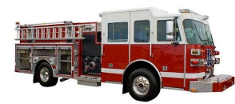
Commercial Item Definition (8)
  A nondevelopmental item, if the procuring agency determines that the item was developed exclusively at private expense and sold in substantial quantities, on a competitive basis, to multiple State and local governments.
  Key Questions/Concepts/Considerations:
    Developed with private funding (tricky when a contractor does a lot of Gov R&D work, need to ensure it is not tied back to a Gov contract).
    Establish substantial quantities.
    Verify competitive sales to State and local governments.
Notes:
Fairly straight forward,
Tricky part with this definition is getting the private funding proof
Key Q
Government, can reimburse the contractors for IR&D as indirect expenses. This method allows the contractor to retain all licensing rights.
Example: Protective vests, stun guns, fire trucks

Slide 32
What are Contractors Required to Provide?
A technical description of the items being offered in sufficient detail to evaluate compliance with the requirements in the solicitation. This may include product literature, or other documents FAR 52.212-1 (b)(4);
Terms of any express warranty FAR 52.212-1(b)(5);
Price and any discount terms FAR 52.212-1(b)(6);
Product samples, when the solicitation so requires FAR 52.202-1(d); and
Description, quantity, unit of measure, unit price and extended price of the items delivered FAR 52.212-4(g)(iv).
FAR 15.403-3(a): If the contracting officer cannot find adequate data elsewhere to determine a fair and reasonable price, he/she shall require the offeror to submit other than certified cost or pricing data:
  (1)(iv) At a minimum, appropriate data on the prices at which the same item or similar items have previously been sold, adequate for determining the reasonableness of the price (unless an exception applies); and
  (1)(ii) Data to support a cost realism analysis.
Notes:
It’s important to understand contractors requirements…
Which again pertain to far part 12 situations
It is the prime contractor's responsibility to make decisions about whether their subcontracts meet the commercial definition. Contractors are expected to exercise reasonable business judgment in making such determinations.
That is the standard we must hold the prime to, no rubber stamp.

Slide 33
NDAA 2016 - Nontraditional Defense Contractors
212.001 Definitions
  “Nontraditional defense contractor means an entity that is not currently performing and has not performed any contract or subcontract for DoD that is subject to full coverage under the cost accounting standards prescribed pursuant to 41 U.S.C. 1502 and the regulations implementing such section, for at least the 1-year period preceding the solicitation of sources by DoD for the procurement (10 U.S.C. 2302(9)).”
DFARS 212.102 (a)(iii)
  In accordance with 10 U.S.C. 2380a, contracting officers may treat supplies and services provided by nontraditional defense contractors as commercial items. This permissive authority is intended to enhance defense innovation and investment, enable DoD to acquire items that otherwise might not have been available, and create incentives for nontraditional defense contractors to do business with DoD. It is not intended to recategorize current noncommercial items, however, when appropriate, contracting officers may consider applying commercial item procedures to the procurement of supplies and services from business segments that meet the definition of “nontraditional defense contractor” even though they have been established under traditional defense contractors. The decision to apply commercial item procedures to the procurement of supplies and services from nontraditional defense contractors does not require a commercial item determination and does not mean the item is commercial.
Notes:
Besides making determinations there are some other changes out there affected the CIG –
Looking at the 2016 NDAA,
A little wordy, but essentially the attempt is to encourage “nontraditional defense” companies (think silicon valley) to do business with the Government. And to incentivize companies to do this, one way is allowing streamlined acquisitions, and minimizing government contracting requirements through commercial procedures.
There is a limit here though, as it states it is not to be used as a tool to overturn prior noncommercial items determinations and while commercial procedures may be issued, a CID is not required and therefore the item or service are not inherently commercial.
Additional components of
NDAA 2016:
- Restricted the PCO’s ability to change a commercial decision; HCA to overturn
- Required a database for recommendations and determinations of commerciality
- Established section 809 panel

Slide 34
NDAA 2018 Sec. 848 – Commercial Item Determinations
Section 848 provides that the DoD’s acquisition of an item through commercial item procedures constitutes a “prior determination” that the item is a commercial item that is binding on future DoD acquisitions unless (i) the head of contracting authority determines that the prior determination was improper or (ii) the senior procurement executive for a military service or the DoD determines that it is no longer appropriate to acquire the item under commercial item procedures. This change may improve consistency within the DoD acquisitions system and streamline the determination process for future acquisitions.
Notes:
NDAA 2018 section 848 moves the regulations to allow the DoD acquisition of an item through commercial procedures to constitute a prior commercial item determination.
We encounter lots of examples where we are told by the contractor that the item is commercial because they have a FAR 12 contract but when we try to locate a CID, either there is no evidence of one or there is minimal evidence a proper analysis was performed.
You can sympathize with the frustration from the contractor, it probably feels like the rug is being pulled out from under them. It is my personal opinion that this NDAA was in response to those grievances, (there’s a reasons why lobbyist are so effective), to allow a sort of grandfathered in approach.
This also aligns with the goals of commercial acquisitions, to streamline the determination process and improve determination consistency.
Table illustration…pulled from a GAO report, represents 5 years of NDAAs and it shows the amount of times a commercial acquisitions is highlighted in an NDAA. Pretty obvious the uptick in occurrence.

Slide 35
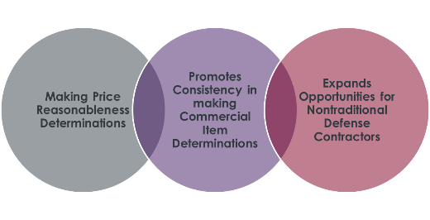
NDAA 2016 vs. NDAA 2018
Conflict between 2016 NDAA and 2018 NDAA
  2018 NDAA directs reliance on prior FAR Part 12 contracts as the commercial item determination (CID); however, FAR Part 12 contracts don’t necessarily mean the items are commercial.
FAR Part 12 procedures = Commercial (NDAA 2018)
Nontraditional Defense Contractors (NDAA 2016) = FAR Part 12 Procedures (212.102)
Nontraditional Defense Contractor ≠ Commercial
Notes:
It a lot to ask but did anyone pick up on the deviation between NDAA 16 and 18?
So on one hand you have NDAA 16, stating that non traditional defense contractors can use commercial FAR part 12 procedures but that it doesn’t constitute a CID, then NDAA 18 states that prior acquisition through commercial procedures constitutes a prior determination. All of a sudden one might think that those non defense contractor items/services are all commercial!
Dilemma of balancing improving CID consistency (18) , while also trying to attract nontraditional defense contractors (16).
No stated resolution to this that I am aware of. I know the CIG submitted a memo to the DAR council in an attempt to address the issue but we’ll just have to wait and see how the DAR council writes up the NDAA 18 regulation and dovetails it into NDAA 16.

Slide 36
NDAA 2019 – New Definitions
Revising Commercial Item Definition
  Separating the old definition into two new definitions, in an attempt to provide clarity:
    Commercial Product – A product of a type customarily used by the general public or nongovernmental entities for nongovernmental purpose and either (1) has been sold, leased, licensed, or offered to the general public, in its original or slightly modified state, or (2) is not yet available but will be in time to satisfy the Government requirements.
    Commercial Service - Services provided to the public, sold competitively in substantial quantities in the commercial marketplace, and procured by the federal Government for support of commercial products.
  New Definitions will take effect on January 1, 2020
    DoD must submit an implementation plan to Congress by April 1, 2019
Notes:
We have the most recent NDAA, which goes about changing the commercial definition. Pretty controversial within congress.
Despite the new nomenclature, the scope and definitions of the two concepts remain largely unchanged.
- Combination of definition 1, 2, 3.
“Commercial services” This is similar to the current services prong of the “commercial item” definition 5 installation, maintenance, repair, and def 6.

Slide 37
Resources at Your Disposal
Department of Defense Guidebook for Acquiring Commercial Items (January, 2018)
CIG Public Webpage https://www.dcma.mil/Commercial-Item-Group/
  DCMA Commercial Item Deskguide (September 2018)
  Helpful links for market research, website specific parts/items, escalation indices, industry resources, etc. (75+ sites, with a brief narrative about the link)
  FAQ’s
CPAC 170 – Commercial Item Support (DoD employees)
If all else fails, contact US, we’re here to support, mentor, troubleshoot, brainstorm…
Notes:
Important to note the DoD guidebook is only a guide, not policy, not regulation. But with the said it’s a real quality public resource.
CIG webpage –
Lots of good information out there, our internal desk guide, rfi template links and websites we utilize, FAQs
CPAC 170 – Course developed in concert with DAU, to assist participants in gaining the skills and knowledge to conduct commercial analysis in compliance with DCMA and DoD policies. 3 day class.

Slide 38
The Future & Where We Go from Here…
Warrant authority gives us a unique opportunity to have a direct affect on streamlining the acquisition process, and providing a more consistent product.
809 Panel Volume 3: Replace commercial buying and the existing simplified acquisition procedures and thresholds, with simplified readily available procedures for procuring readily available products and services and readily available products and services with customization.
Notes:
Touched on the 809 panel briefly but they are result of NDAA 2016, and they are an independent advisory panel attempting to streamline and improve the efficiency and effectiveness of the defense acquisition process and maintaining defense technology advantage.
809 recently came out with their recommendations and in volume 3…bold suggestion attempting to limit commercial and SAT procedures and thresholds. So totally eliminating commercial buying procedures.
That coupled with the new definition, and our warrant authority, the CIG will have an interesting and exciting future ahead of us.
In a short 3 years, the CIG has come a long way in defining our roles within the agency, establishing best practices, creating a deskguide, engaging private industry, introducing ourselves to the major buying commands, put on a week long CIG conference, creating and rolled out a commercial training course, and that’s not an all inclusive list. We expect to expand our roles and grow and go where the commercial market takes us. But currently on the docket we are looking to increase our participation with buying commands specifically with pre-solicitation work, in an attempt to be proactive rather than reactive.
Commercial products and services are cutting edge and dynamic and the CIG strives to provide that same level of services and insight for the DoD.

Slide 39
Today’s CIG
New CIG Thresholds
  Commercial Only Cases: $1 M
  Commercial and Pricing Cases: $1 M
  Pricing Only Cases: $2 M
      CMOs can perform price analysis requests under $2M
Commercial Request Form:
  dcma.boston-ma.eastern-rc.mbx.Commercial@mail.mil
  Or visit our website:
  https://www.dcma.mil/Commercial-Item-Group/
New Deliverables
  CPAR – Drafted by Price/Cost Analyst
  CTAR – Drafted by CIG Engineer, sent to CIG CO to assist in their CID
  CID – Drafted and Signed by CIG ACO
Notes:
Threshold change coincides with the new TINA threshold.
We are looking into way to better prioritize work/cases, playing around with the idea of risk based thresholds.
Email address is a bit of a mouthful so its helpful to submit a request form right from our website.
New division of labor, eng, pricers, and CIG KO have separate deliverables, tech, pricing and determination reports.

